Slide 1
Issues in buying a used car
Persona Presentation
Colby Lewis
Tony Nguyen
Josue Cerritos
Hoang Vo
Kent Nguyen

Slide 2
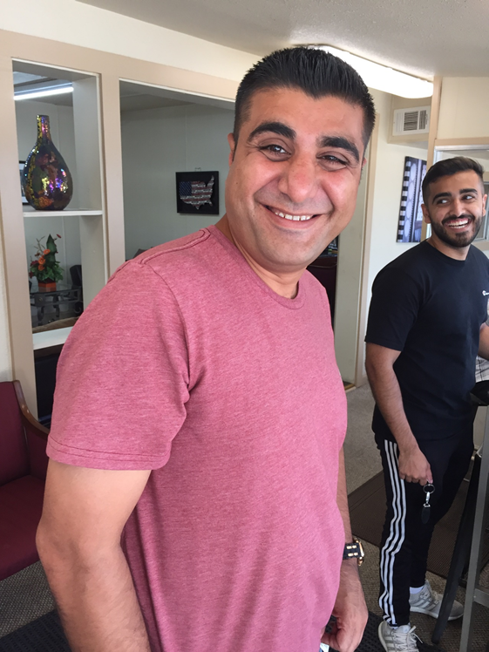
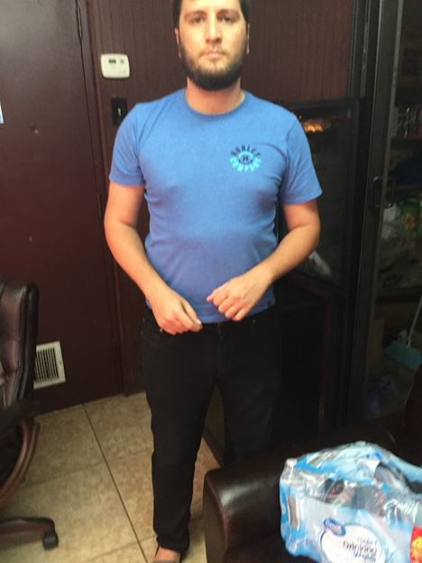
Ricardo
Sam

Slide 3
-Priorities:
good, clean, and new-looking cars for pictures
Details that can make the cars nice enough
-Fear:
customers know nothing about cars
customers hate cars with crashing history.

Slide 4

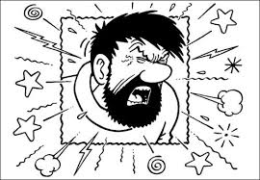
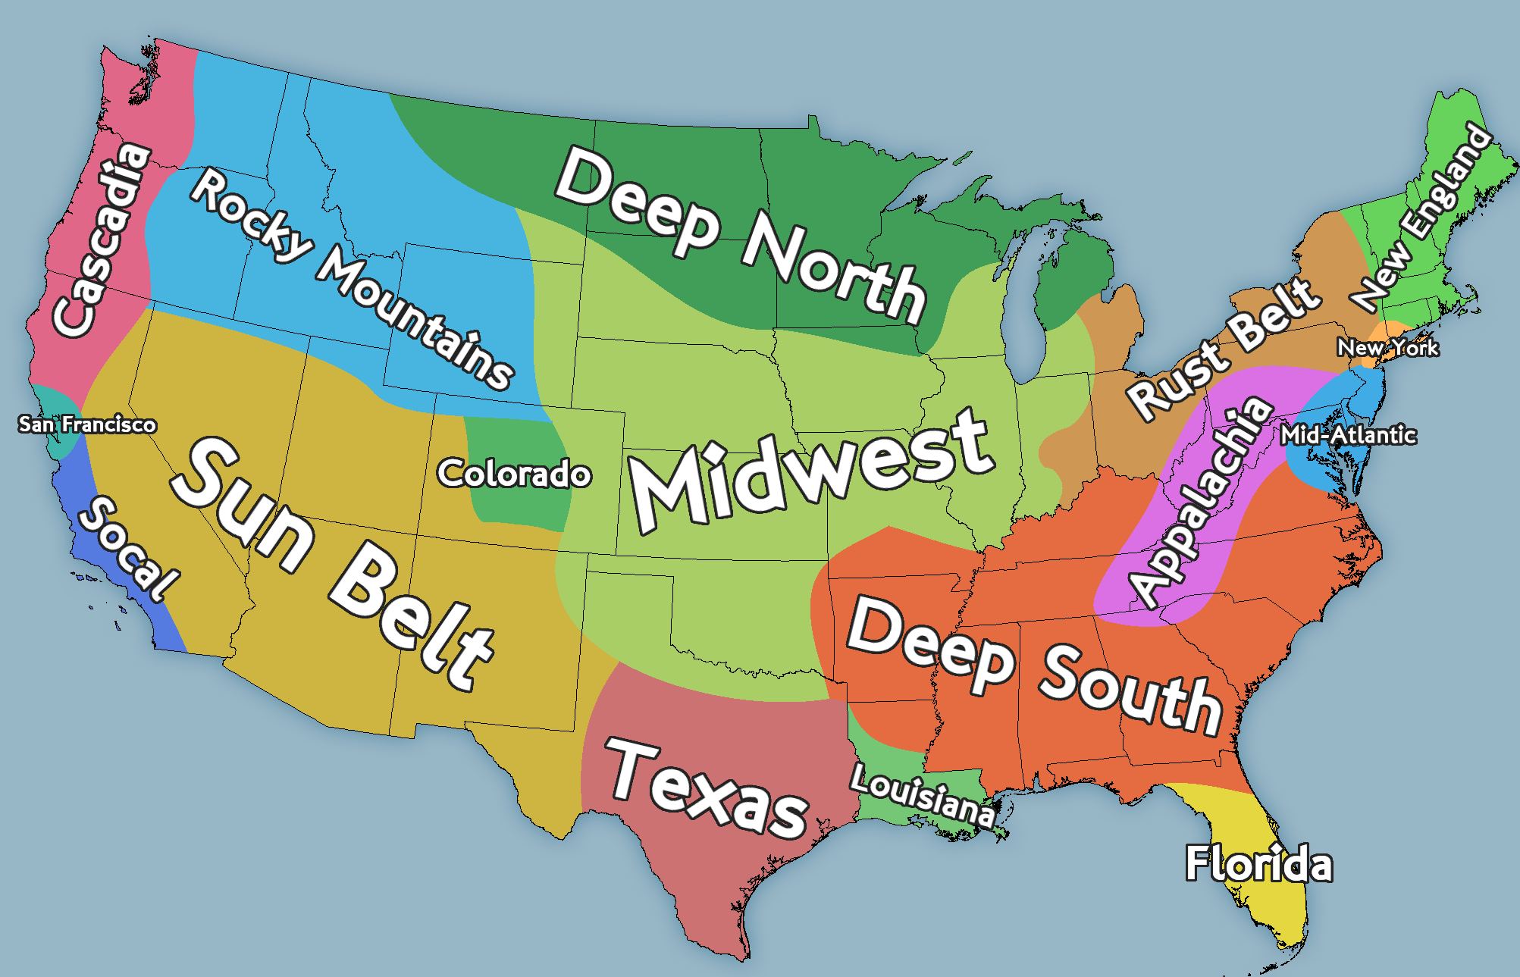

Water holes

